Slide 1


Java/OOP/UML Project
Group 2

Slide 2
Members of the group
Joël DIDIER: Project Manager, Database Master, Documentation Advisor, Level Designer
Nicolas DRAPIER: Lead Java Developer
Thomas LOURENCO: Documentation Master, Java Developer, Translator
Bastien LE GALL: Java Developer, Game Tester

Slide 3
Table of Contents
Overview of the game
Technical explanations
Diagrams
Code
Functional explanations
Goal
Rules
Functioning
Points
Demo of the game

Slide 4
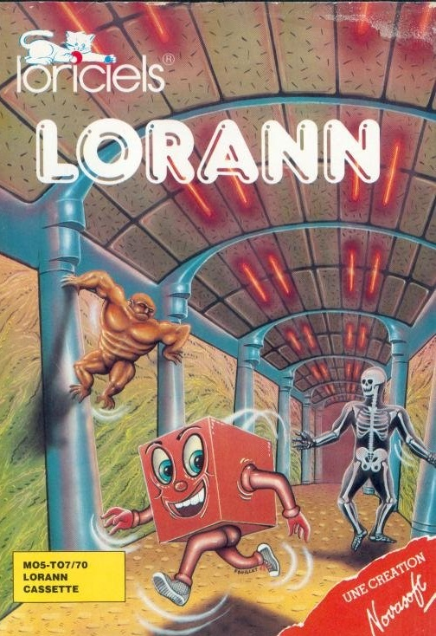
Overview of the game
Lorann is a game that was created in 1985 by the former French Game Development Studio Loriciels and edited for Thomson MO5 and TO7 computers.
This is a PacMan-like game which means that a single character moves square-by-square while collecting a maximum of items to advance to the next stage.

Slide 5
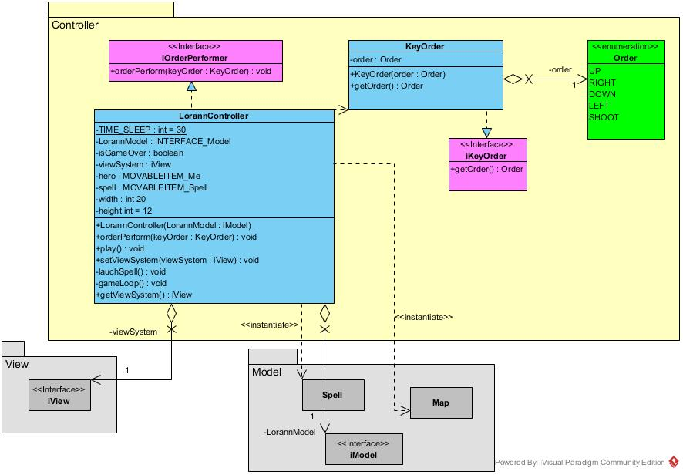
Technical explanations

Slide 6
Technical explanations
Manque le code

Slide 7
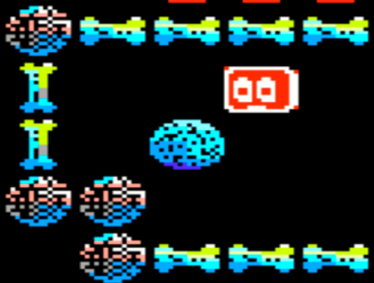
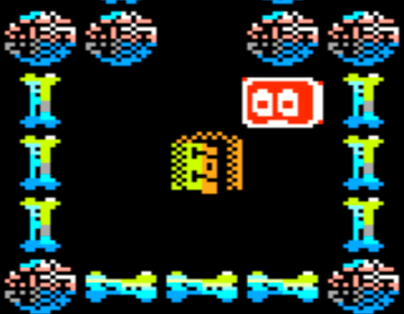
Functional explanations
Goal:
The goal is to achieve to go out by the door. To open the door, you must find the Energy bubble.

Slide 8
Functional explanations
Rules:
There is no time limit to finish any level.
Lorann can move in any direction (left, right, up, down, all diagonals).
Lorann cannot go through walls (Pillars, Horizontal and Vertical Bones).
Lorann can get killed if he encounters one of the following:
The closed door leading to the next level
Any of the 4 monsters
Lorann can kill the monsters only using his Spell.
Lorann can cast his Spell only once at a time, and must grab it back (by going on it’s way) to cast it again.
Monsters cannot go through walls.

Slide 9
Functional explanations
Functioning:
Lorann can be leaded by 3 types of keycaps:
The Arrow keys
The ZQSD keys
The WASD keys
The Spell can be casted by the use of the SPACE key.
A level can be retried by the use of the R key. This action will cost a few points to the player.

Slide 10
Functional explanations
Points:
You can earn points by many ways:
Collecting a Purse grants 50 points
Killing a Monster grants 50 points
Passing through the Door grants 100 points
You can use the retry button to restart a level, but 150 points will be used.

Slide 11
Demo of the game
(démo du jeu en direct live sur vos postes radio au 107.7)

